Slide 1
Discussion Forums

Slide 2

Blog
A website containing entries, or posts, in a reverse chronological order with the most recent appearing first.
According to the website, the entries are in a format similar to a journal.
Blog is also called a web log.

Slide 3
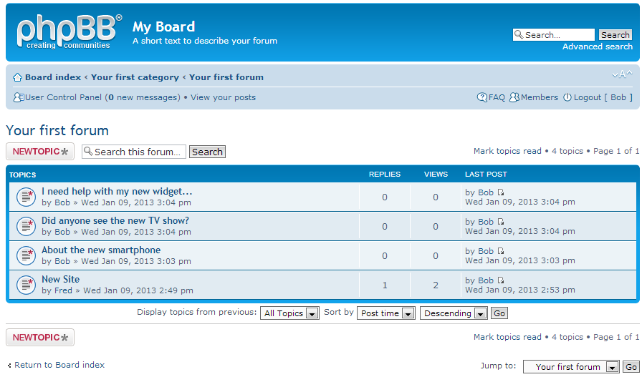
Bulletin Board
An online communication system where one can share, request or discuss information on any topic.

Slide 4
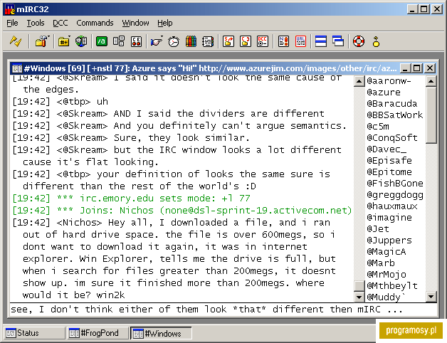
IRC
The acronym stands for Internet Relay Chat.
It is a messaging system that allows users to chat with other people over the Internet using text messages.

Slide 5
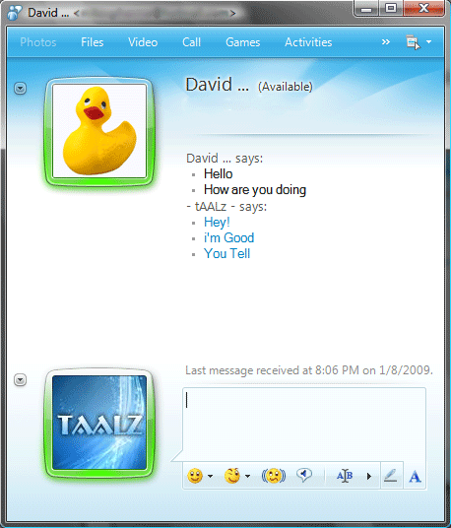
Instant Messaging
Type of online chat that offers real-life text transmission over the Internet.

Slide 6
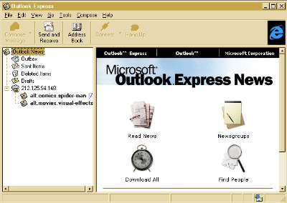
Newsgroups
An online discussion group or forum specifically focused on a particular area of interest.

Slide 7

Podcasts
An audio broadcast using the Internet that can be played back on a iPod or similar device.

Slide 8
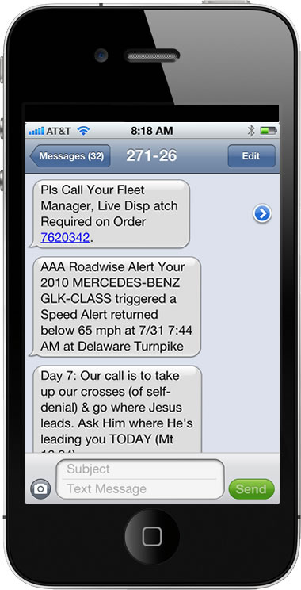
SMS
The acronym stands for Short Message Service and is commonly known as a ‘text message’.
It is a short message sent from one mobile phone to another.

Slide 9

Webcast
A video broadcast or media presentation distributed over the Internet.
It refers to broadcasting over the Internet.

Slide 10

Webinar
A live meeting that takes place over the Internet. Shared audio allows for presentations and discussions.

Slide 11

Wiki
A website developed that allows any user to edit and add content.

